Slide 1
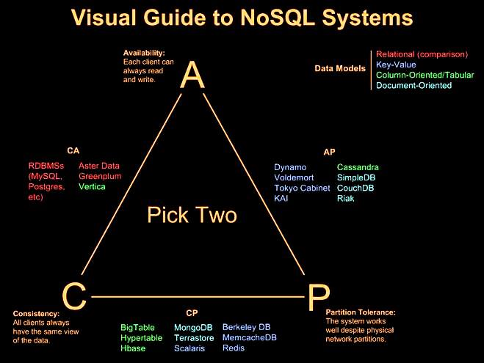

Slide 2
PILOT STUDENTS – Oct/Nov 2015 (this applies to you)
(1) When you see an instruction to upload something, upload it to your desktop. If faculty needs it, they will ask for it.
(2) Contact info is in the FAQ for any issues.
Intro to NoSQL - Module 3
Document Storage DBs
Notes:
Note to Narrator: Do NOT narrate any words, acronyms, or anything enclosed in ( ) that’s in the narrative script.

Slide 3

This Week’s Outline
Introduction to Document Based Databases
History of technology
Major release schedule
How this technology differs from traditional data architecture and Hadoop specifically
Major vendors
MongoDB
CouchDB
Limitations and Considerations
Cost of vendor(s) technology / tools
What are the key decision points driving a use case for this technology? (Cost, security, functionality, capability, performance, etc.)
What is this technology NOT good for
Conclusion
Notes:
Narrative:

Slide 4
Document Oriented Database
Document oriented database is basically a collection of documents
Data in this model is stored inside documents
A document is a key value collection where the key allows access to its value
Documents are not typically forced to have a schema and therefore are flexible and easy to change
Documents are stored into collections in order to group different kinds of data
Documents can contain many different key-value pairs, or key-array pairs, or even nested documents
Notes:
Documents are the main concept in document databases. The database stores and retrieves documents, which can be XML, JSON, BSON, and so on. These documents are self-describing, hierarchical tree data structures which can consist of maps, collections, and scalar values. The documents stored are similar to each other but do not have to be exactly the same. Document databases store documents in the value part of the key-value store; think about document databases as key-value stores where the value is examinable.

Slide 5
Relational vs Document Model Comparison
Here is a comparison between the classic relational model and the document model:
Relational model | Document model
Tables | Collections
Rows | Documents
Columns | Key/value pairs
Joins | Not Available
Notes:
It lacks any table JOINs, which avoids performance bottlenecks seen with traditional SQL servers.

Slide 6
Suitable Use Cases
Event Logging
Content Management Systems, Blogging Platforms
Web Analytics or Real-Time Analytics
E-Commerce Applications

Slide 7
When Not to Use
Complex Transactions
Many operations being executed across one data set
Queries that require distinct data within a document and across multiple documents
Queries against Varying Aggregate Structure
Data cannot be normalized in document databases
Time Series, Event Based Data May be More Suitable for Alternate Technologies

Slide 8
Major Vendors:
MongoDB

Slide 9
Major Vendors - MongoDB
Overview of technology
Architecture: Replication, Data Model, etc.
Usage:
Code and deployment information
Lab 1 - Start up, basic procedures
Site to download sandbox/get software
Instructions to download, configure and operate
Lab 2 - 3 - Industry Use Case 1 -2
Problem statement
Technology as a solution
Neat facts
Notes:
Narrative:

Slide 10
MongoDB Overview
Short for humongous
Open source with development lead by 10Gen
First public release in 2009
Document based
Documents contain the actual data, which is stored as binary JSON objects of a fixed maximum size
Schema-less
Highly scalable
Data is sharded, not automatically replicated so it requires less infrastructure to scale
Notes:
History
Development of MongoDB began in October 2007 by 10gen. The first public release was in February 2009.
MongoDB is a document database. Documents are stored in collections, and collections are in turn stored in a database. A collection is similar to a table in MySQL (it’s a named group of documents), but a collection lacks any schema.
MongoDB uses (auto) sharding, not replication, as a way of achieving high scalability. Sharding essentially involves "breaking your database down into smaller chunks called shards and spreading those across a number of distributed servers.

Slide 11
MongoDB Overview Cont.
A MongoDB instance is made up of a number of databases
These contain a number of collections
Collections can be nested for heirarchy
Comparative to MySQL databases and tables
GridFS support
Distributed file storage for larger files over the 4MB standard limit
GridFS splits large files into smaller chunks before the files are stored into the collection
Notes:
Queries are expressed as JSON-style objects, making it pretty painless to save and retrieve data
GridFS specification of MongoDb supports storage of very large files.

Slide 12
MongoDB Key Terminology
Databases : JSON-like objects comprising the data model and the data.
MongoDB does not support joins
Secondary indexing improves query performance
Users fetch data in a query language
Writes are atomic (unique) per document, reads are fully consistent
Schemas : The structure of the data
Schemas are dynamic
Collections can be created without pre-defining a structure for the schemas
Collections : Similar to a table in a relational database
Collections hold one or more documents
Documents correspond to a row of data in a relational model
Documents have field names, which correspond to a column in a relational model

Slide 13
MongoDB Key Terminology Cont’d.
Chunk: An initially empty keyspace that gets populated with data (64MB limit by default)
Shard: A logical partition of data hosted on one or more Mongo databases
Replica set: A physical set of mongod servers that maintain replication of one shard
mongod: Mongo command for database
mongos: Mongo command for a shard router
mongoc: Mongo command for the configuration server which keeps track of where each chunk is in the key range

Slide 14
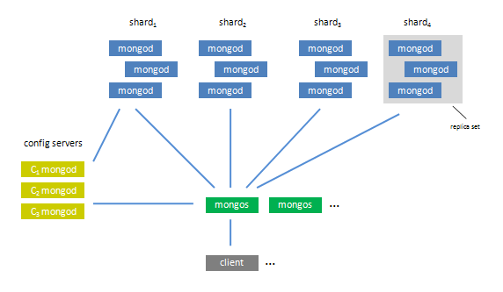
MongoDB Logical Architecture
Client applications communicate with the mongos shard and mongoc config servers to determine where the data is stored
Notes:
Source: http://www.mongodb.org/display/DOCS/Sharding+Introduction

Slide 15
MongoDB Data Model

Slide 16
Data Model Overview
MongoDB stores data in unstructured collections
Documents within a single collection generally share a similar structure
Indices can be added to objects in a collection to improve i/o throughput
No single operation can affect more than one document or collection
Two methods to represent relationships in Mongo:
References: relationships between data that link information from one document to another
Embedded data: relationships between data within a single document
Notes:
What does this mean? How would this affect how you want to model your data?

Slide 17
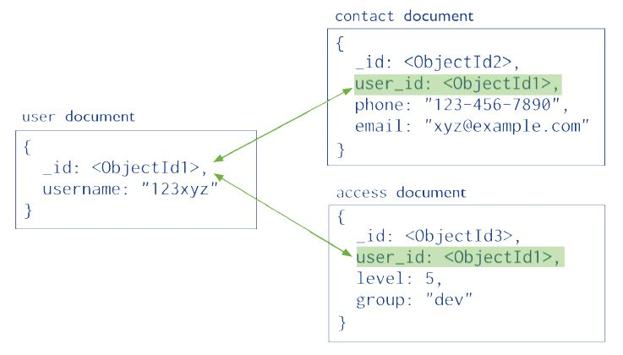
Reference Data Models
Can represent complex many-to-many relationships efficiently
Reduces data duplication
Can be used to model hierarchical relationships
Applications querying data must issue several queries to resolve references

Slide 18
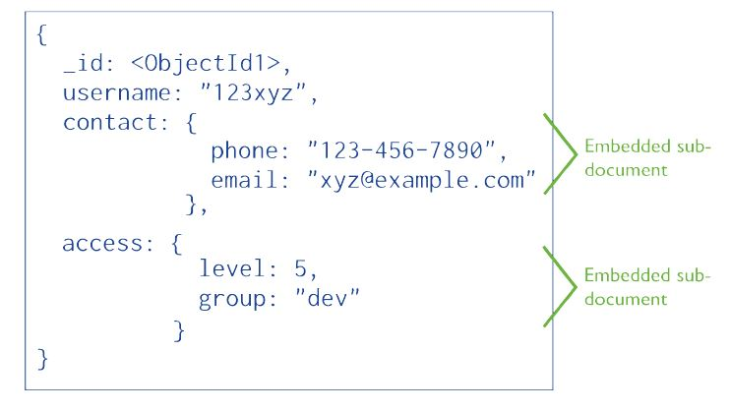
Embedded Data Models
Allows a developer to store related pieces of information in the same database record
Very good for one-to-many relationships (one parent document can have several child sub-documents)
Better performance for read operations
Embedding data causes documents to grow – there is a limit to how big a document may grow to be, this limit is configurable but may have performance implications
Notes:
Why would embedding provide better performance for read operations?
How would a larger document lead to performance implications versus a smaller document?

Slide 19
Choosing a Data Model – Operational Factors
Document Size & Growth
Atomicity
Sharding
Indexes
Quantity of Collections
Data Lifecycle Management

Slide 20
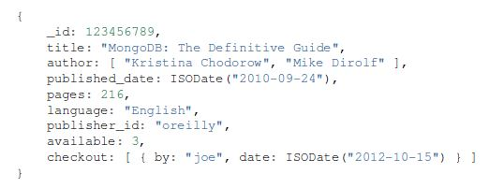
Example: Data Modeled for Keyword Search
If your application needs to query data for exact text matches the $regex command can be used to do simple regular expression matches
This is done by creating an array field in the document and adding the keywords as strings in an array
Create an index on the array that lists your keywords:
db.volumes.createIndex ( { topics : 1 } )
This multi-key index creates an entry for each keyword in the array. The application then queries based on a keyword;
db.volumes.findOne ( { topics : “voyage” }, { title : 1 } )
Notes:
This is not the same as full tezxt search, and does not do advanced text processing operations.

Slide 21
MongoDB Architecture

Slide 22
MongoDB Features
File Storage (GridFS)
Stores large files and file meta-data
Capped Collection (like Ring Buffer)
Older documents auto-deleted via lifecycle management
Geo Indexing Capabilities
Determine how close one data point is to another
Auto sharding
Data automatically divided upon write
High availability

Slide 23
Matching Requirements to Features
Read scalability and High Availability (HA)?
➔Use Replica Sets
Write scalability?
Use autosharding to improve write performance
Durability?
➔Use journaling feature
HA, Read Scalability, and Write Scalability?
Use Autosharding and Replica Sets
Autosharding and replica set capabilities can be adjusted and added to meet business needs. Proper capacity planning and monitoring help in determining which features best fit the business and technical requirements.

Slide 24
Journaling
Feature added in 1.8, and is now default for 64 bit OS for MongoDB 2.0
Write operations are stored and executed in memory and in the on-disk journal before presented as readable data files
Writes are atomic, ensuring consistency
When feature is enabled, MongoDB creates a subdirectory that holds journal files
Journal files are append-only, once all the write operations specified in a journal file are complete the file is deleted
Prior to this feature, replication was used
MongoDB did not have single server durability, now it does with addition of journaling
More information available here:
https://docs.mongodb.org/manual/core/journaling/

Slide 25
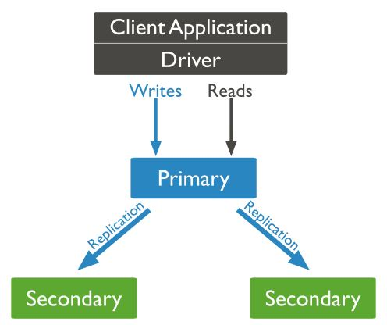
Replication & Replica Sets
A replica set is a group of mongod processes that hold the same data set to provide high availability and redundancy
Replica sets protect an application from the failure of a single data server or infrastructure service interruption
Replication can also be sued to increase read capacity, as client servers ae able to send read and write operations to separate servers
The primary mongod set receives all write operations, while all other mongod sets are secondary instances and apply operations from the primary
Secondary instances apply operations from the primary asynchronously to protect in case of a service failure
More information available here:
https://docs.mongodb.org/v3.0/replication/
Notes:
MongoDB supports master-slave replication and a variation on master-slave replication known as replica sets. Replica sets are the recommended replication topology.
Replica Sets and Autosharding go hand in hand for mass scale out
Replica Sets are good for failover and speeding up reads, but ……
To speed up writes, you need autosharding

Slide 26
Replica Sets Usage
Business Continuity
Data Redundancy
High Availability
Load Sharing (reads)
“Just works / NoOps (low ops)”

Slide 27
Sharding
Sharding allows MongoDB to scale horizontally
Sharding is the equivalent of partitioning in columnar storage
MongoDB autoshards data as it is written
Autosharding increases writes, helps with scale out
Data will automatically be load balanced
As new nodes are added scaling is elastic
Support automatic failover (along with replica sets)
Not always necessary - 90% of deployments don’t need sharding according to Roger Bodamer (10gen Founder/CEO)

Slide 28
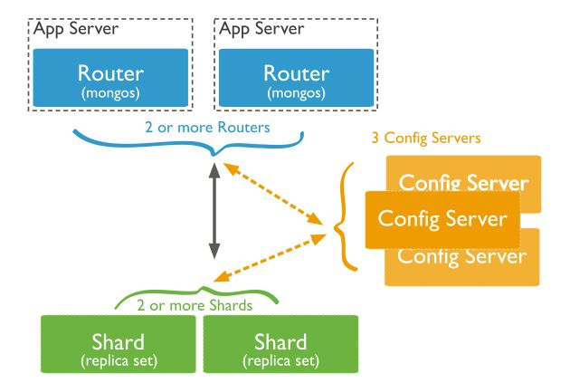
Sharding Architecture
Configuration Servers (mongod)
Hold sharding metadata and topology, version controlled
Acts to ap which shard has key for data to be retrieved
Used by mongos
Similar to a DNS server
Mongos
Obfuscates process: Shard route clients drivers talk to mongos instead of mongod directly
Mongos uses Config servers to find shard where key lives

Slide 29
Mongo DB Processing: MapReduce
Similar to Hadoop, MapReduce is used for batch processing
MapReduce allows for larger aggregation through dividing the work tasks among different Mongo nodes
Map and Reduce functions are written in JavaScript
Executed on server, code next to data it is operating on
Can copy processing results directly into new or updated collections

Slide 30

Industry Use Case:
Problem: Expedia users search multiple business lines to book travel: flights, hotels, etc. which all have different attributes. In addition customers may be not be logged in, making it very difficult to normalize the customer and save their search information
Solution:
A team of 3 MongoDB developers built Scratchpad – an application that lets shoppers discover and store their trip in different optimized ways
Scratchpad automates the note taking process for the user and also intelligently remembers previous searches across devices
Because MongoDB has a flexible data model a wider variety of data, from city maps to flight data to calendar dates can be saved in one place
MongoDB indexing allows Expedia to make personalized suggestions to customers in near real time as they shop on the site
Scratchpad keeps users from moving to other travel sites by creating a customized travel plan, it has also dramatically increased conversion rates for Expedia.
Notes:
Scratchpad makes the travel search process fast, easy, and personalized. It keeps people from jumping to other travel sites. And it dramatically increases conversion rates for Expedia. That’s a competitive edge for Expedia that wouldn’t have been possible without MongoDB.

Slide 31
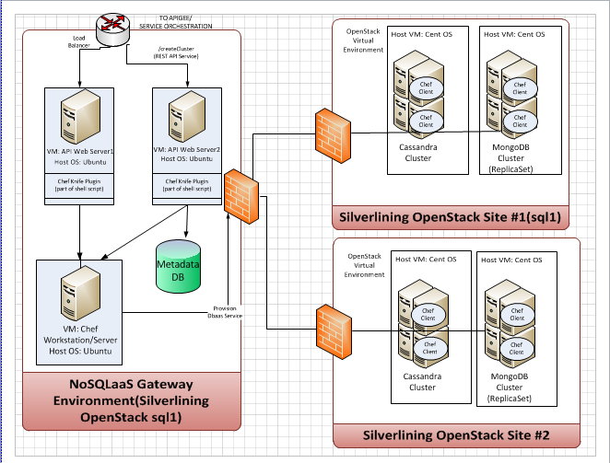
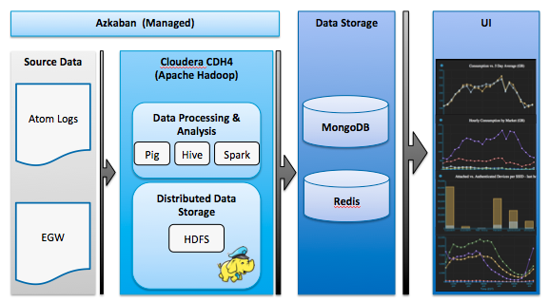
MongoDB in the Enterprise Ecosystem
Most often used in conjunction with other data stores in the enterprise
Used as data storage for front end applications, receives data from large Hadoop data store

Slide 32
Major Vendors:
CouchDB

Slide 33
CouchDB Overview
A NoSQL Database Management System (DBMS)
Document Oriented like MongoDB
Under Apache license but open source
Coded in Erlang programming language
Is built and optimized for the Web
Contains an HTTP Server
JavaScript Queries
Scales well across several servers

Slide 34
CouchDB Overview Cont.
Stores data in JSON text documents
Provides ACID semantics
Uses JavaScript for views via MapReduce processing famework
Distributed and Replication oriented
REST API provided for simple HTTP calls
Can run offline

Slide 35
Data Model in CouchDB
Each document contains an id and a revision number
Each update to a document creates an new version, with the same _id but a new revision number
Validation functions can be assigned to a collection
Any document inserted or updated must be validated by these functions to provide adhoc type data validation
A view is a new key-document collection, specified via MapReduce processing
Documents can be replicated in other CouchDB instances to provide consistency in the event of a failure or service outage

Slide 36
CouchDB Features
Data Representation – JSON data structures
Interaction - Futon/CouchDB API
Querying - Map/Reduce processing
Design Documents - Application code (Language: Javascript)
Documents can have attachments that embed more data

Slide 37
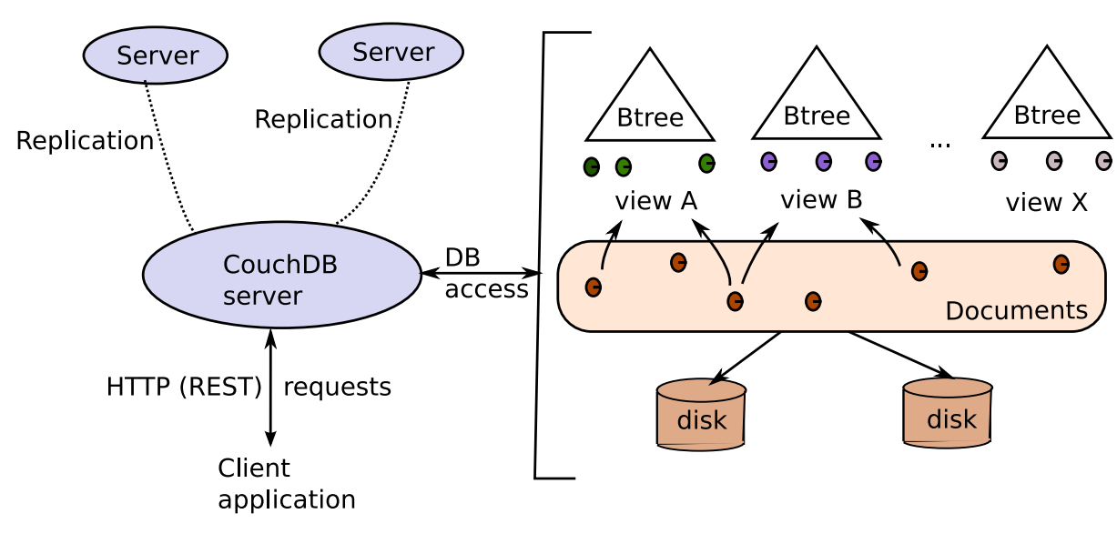
Architecture of CouchDB
Clients interact with the main CouchDB server via REST commands
CouchDB server contains information about where data is stored in documents
Views are created from documents when query statements are executed
Core document data is stored onto disk

Slide 38
HTTP REST API
Simple HTTP queries
GET, POST, PUT, DELETE, HEAD, COPY
Possible to manage using Futon interface

Slide 39
Example: HTTP Queries using curl
Access to server information
curl http://127.0.0.1:5984
{ "couchdb": "Welcome", "version":"1.1.0" }
Creating a database
curl -X PUT http://127.0.0.1:5984/wiki
{"ok": true}
Retrieve database information
curl http://127.0.0.1:5984/wiki
{ "db_name": "wiki", "doc_count": 0, "doc_del_count": 0, "update_seq": 0, "purge_seq": 0, "compact_running": false, "disk_size": 79, "instance_start_time": "1272453873691070", "disk_format_version": 5 }

Slide 40
Example: HTTP Queries Using Curl Cont’d.
Creating a document
curl -X POST -H "Content-Type: application/json" --data \ '{ "text" : "Wikipedia on CouchDB", "rating": 5 }' \ http://127.0.0.1:5984/wiki
{ "ok": true, "id": "123BAC", "rev": "946B7D1C" }
Delete a database
curl -X DELETE http://127.0.0.1:5984/wiki
{"ok": true}

Slide 41
Advantages vs Disadvantages of CouchDB
ADVANTAGES
User friendly
Fault tolerant
Scalable
Self-contained data
DISADVANTAGES
Numerous constraints – have to interact via REST server to interact with data which can cause deployment complications
Not widely used in the industry so may be difficult to source developers

Slide 42


Industry Use Case:
Problem: The European Organization for Nuclear Research (CERN) generates and utilizes tens of petabytes of data per year at inconsistent growth rates.
Solution:
CouchDB is well suited for applications that do not have well understood sizing requirements
CERN users query a large amount of data at one time through web interfaces, which is done easily in CouchDB
CouchDB data store runs on mobile devices and a variety of operating systems being utilized by users
CouchDB is also ideal for users that want to work offline and sync data versions in bulk when users reconnect to the network
Notes:
CouchDB scores highly for applications in which data is accumulated without any sizable requirements for modification. The 10 PB of data (1 PB is one US billion gigabytes) of data to be collected annually in the ‘Compact Muon Solenoid’ experiment at CERN, the European Organization for Nuclear Research, is one example of a choice made to use CouchDB. Its ‘views’ functionality then allows users to query a large amount of data rapidly. CouchDB also interfaces easily to other systems, such as Oracle databases. A further advantage of CouchDB is in its features for deployment on mobile computing devices. The data store runs on Android, as well as BSD, Linux, OS X, Solaris and Windows. Written in Erlang, CouchDB adapts well to different sizes of computing device. It also allows users to work offline and to sync up their version of the database again when the next network connection is made.

